Slide 1
Touro Hackathon 2020
IHS Markit Challenge
Tamar Aufrichtig, Ayelet Buchen, Esther Farkas, Jennifer Gerstle

Slide 2
The Challenge
IHS Markit is looking for a project that can integrate seamlessly to their pre-existing products. Their main requirements are user-accessibility and personal human interaction.
We must create a project that combines easy interaction between client and server and optimizes the usage of the product.

Slide 3
Our Idea
We created a program that can be implemented into the pre-existing software as a sidebar. The sidebar would appear, unobtrusively, on every tab or page of the product. As the user navigates the software, they can click on the sidebar and review the communication options.
The user can decide between a text, call, screen-share, web-chat, or Skype. A real-time company representative will be on hand to answer any of the questions. The client can continue using the software while they are in contact with the representative, or they can end the communication and continue alone.

Slide 4
Implementation
Using HTML, we created a webpage that IHS can restructure into a sidebar.
We created buttons with different channels of communication.
Clicking on the buttons will redirect to specific communication websites like email or Skype
Or it will prompt for information regarding direct contact, such as a phone number for a text or phone-call.
Or it will open a pop-up box for web-chatting

Slide 5
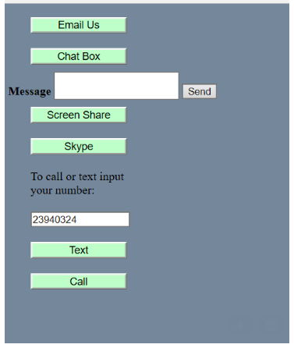
Example of Code

Slide 6
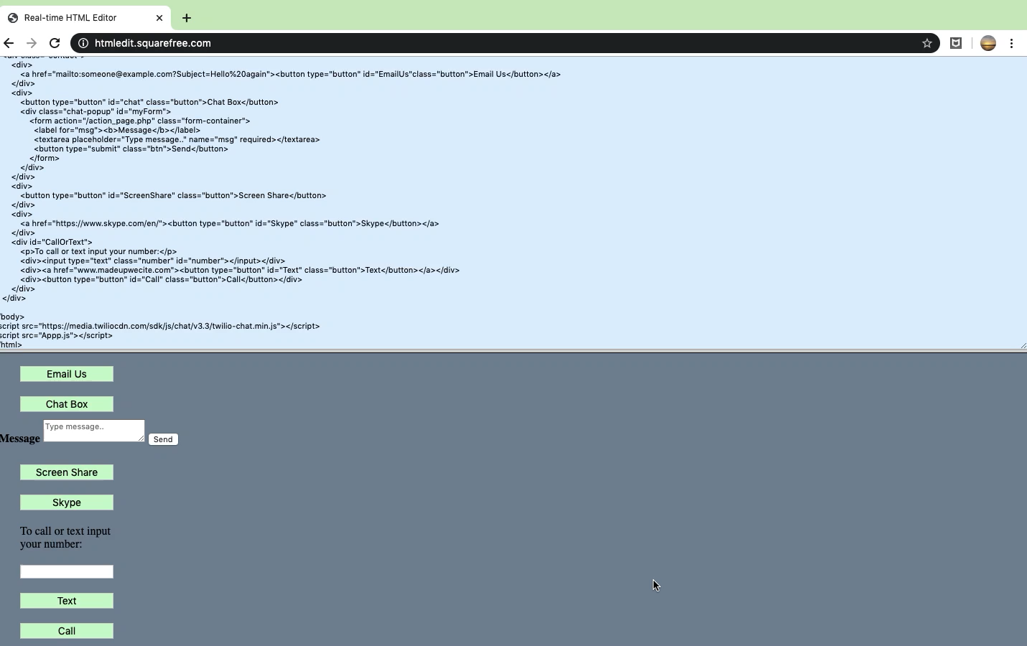

Slide 7
!DOCTYPE html>
<html class="no-js" prefix="og: http://ogp.me/ns#">
<style>
body{
background-color: lightslategray;
}
.button {
background-color: #ccffcc;
color: black;
margin: 10px 30px;
text-align: center;
text-decoration: none;
display: inline-block;
font-size: 14px;
width: 130px;
}
.button:active {
background-color: cadetblue;
}
input, p{
margin: 10px 30px;
width: 130px;
}
.myForm
{
visibility: hidden;
}
.myForm:active
{
visibility: visible;
}
</style>
<head>
<title> Hackathon</title>
</head>
<body>
<div class="contact">
<div>
<a href="mailto:someone@example.com?Subject=Hello%20again"><button type="button" id="EmailUs"class="button">Email Us</button></a>
</div>
<div>
<button type="button" id="chat" class="button">Chat Box</button>
<div class="chat-popup" id="myForm">
<form action="/action_page.php" class="form-container">
<label for="msg"><b>Message</b></label>
<textarea placeholder="Type message.." name="msg" required></textarea>
<button type="submit" class="btn">Send</button>
</form>
</div>
</div>
<div>
<button type="button" id="ScreenShare" class="button">Screen Share</button>
</div>
<div>
<a href="https://www.skype.com/en/"><button type="button" id="Skype" class="button">Skype</button></a>
</div>
<div id="CallOrText">
<p>To call or text input your number:</p>
<div><input type="text" class="number" id="number"></input></div>
<div><a href="www.madeupwecite.com"><button type="button" id="Text" class="button">Text</button></a></div>
<div><button type="button" id="Call" class="button">Call</button></div>
</div>
</div>
</body>
<script src="https://media.twiliocdn.com/sdk/js/chat/v3.3/twilio-chat.min.js"></script>
<script src="Appp.js"></script>
</html>

Slide 8
Intended effect
IHS Markit works with billion-dollar corporations, banks, and hedge-funds that handle many large-scale transactions daily. It is important for software to be fast, effective, and intuitive. However, efficient software is not always easy to understand from a user perspective.
Additionally, it is important that clients, no matter how large or small, can easily contact IHS Markit with their questions and comments, in order to foster a strong relationship between the two.
A sidebar with various forms of contact available will streamline a once-confusing process, allowing companies to conduct their business more efficiently. They will be secure in the knowledge that they are utilizing the product in the optimal way.
The availability of real-time conversation with a trained representative will also foster a stronger relationship between the the client and the provider.

Slide 9
Thank you!

